Slide 1
AALBERT
Audio ALBERT: A Lite BERT for Self-supervised Learning of Audio Representation

Slide 2
Recap: ALBERT
Factorize Embedding Matrix
Share Parameters across layer
Model Configuration between BERT

Slide 3
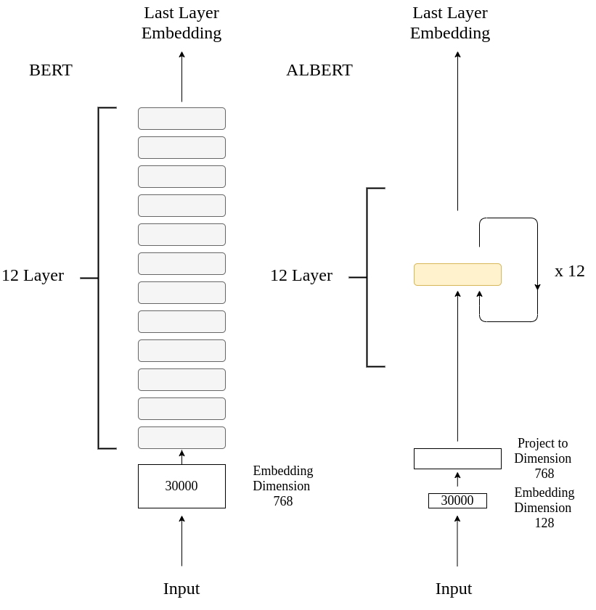
ALBERT
1.Factorize Embedding Matrix
Original BERT:
30000 x 768 = 23.04M
ALBERT:
30000 x128 = 3.8M
128 x 768 = 0.098M
Total: 3.898M
Reduce Parameters !

Slide 4
ALBERT
2.Shared Same Parameters across Layer
1/ 12 BERT Parameters on Layer
Reduce Parameters !!!

Slide 5
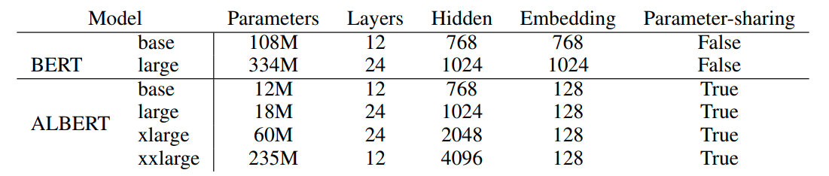
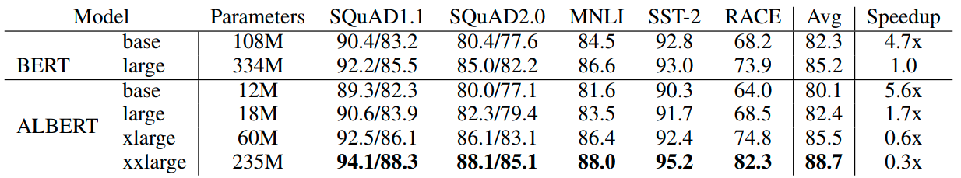
Model Configuration

Slide 6
AALBERT

Slide 7
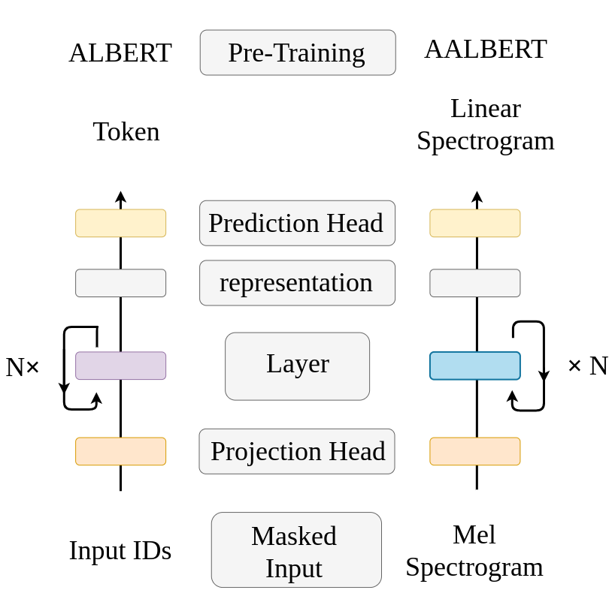
v.s ALBERT

Slide 8
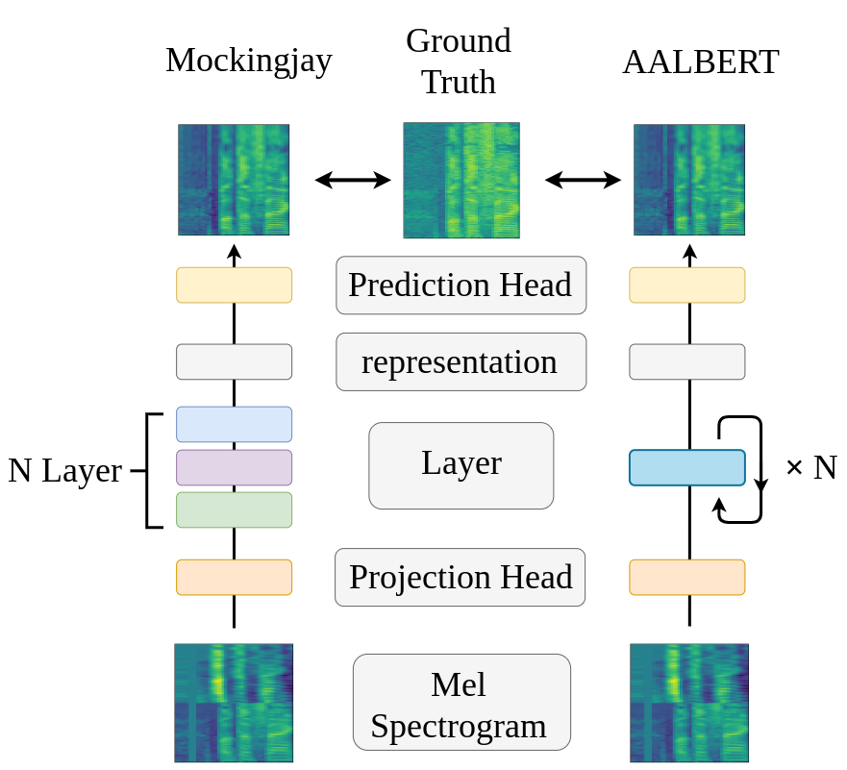
v.s Mockingjay

Slide 9
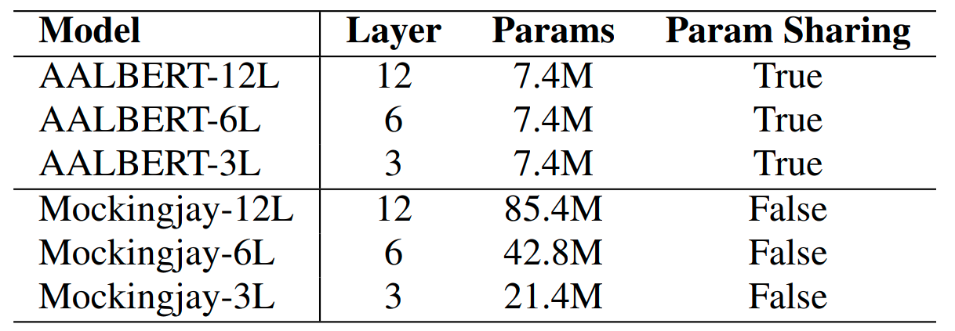
Configuration

Slide 10
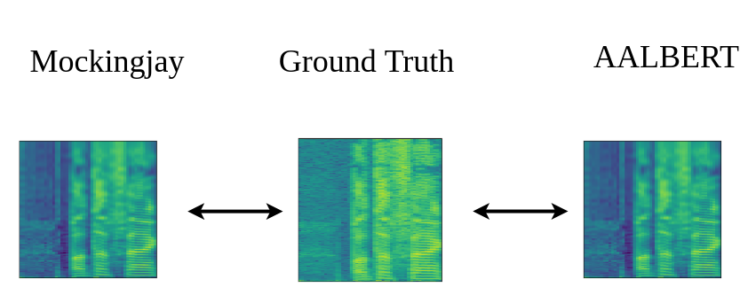
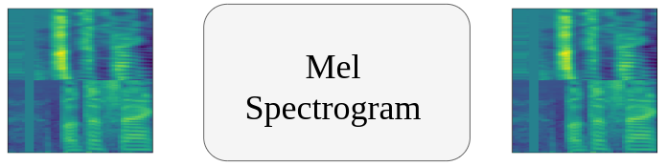
Pre-Training Stage
LibriSpeech 360 hours dataset, 500k step, batch size 48.

Slide 11
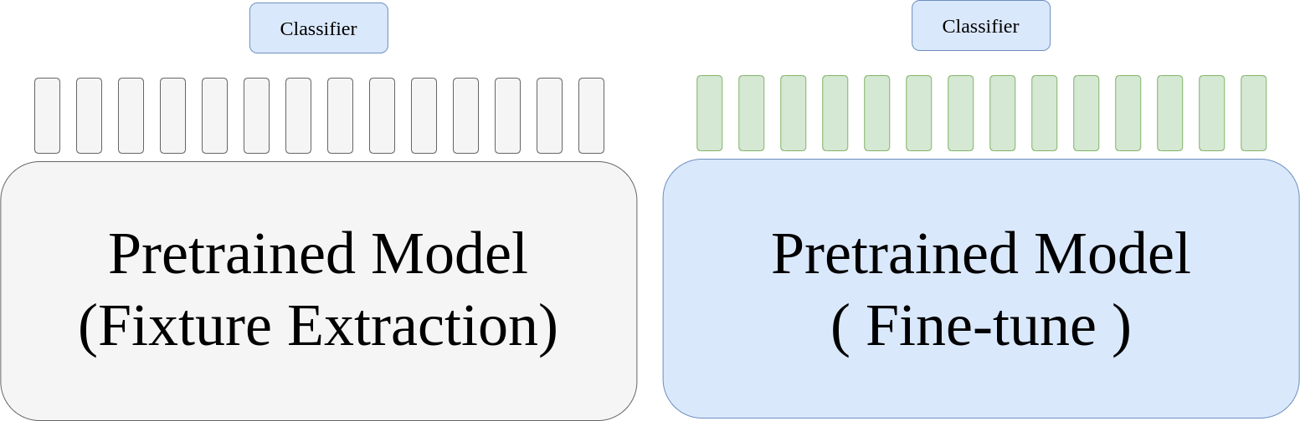
Phoneme Classification
Weighted-sum and fine-tune feature extraction
Different Proportion of training data

Slide 12
Phoneme Classification task
Utilizing MLP classifier behind representation to train phoneme classification task.
Weighted-sum, Fine-tune.

Slide 13
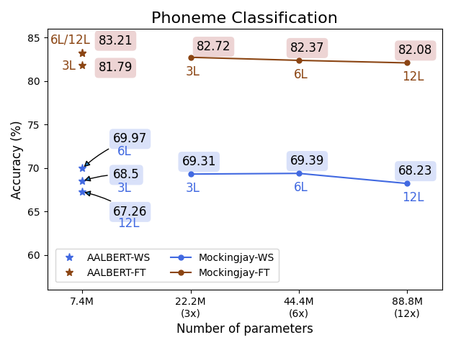
Weighted-sum and Fine-tune version

Slide 14
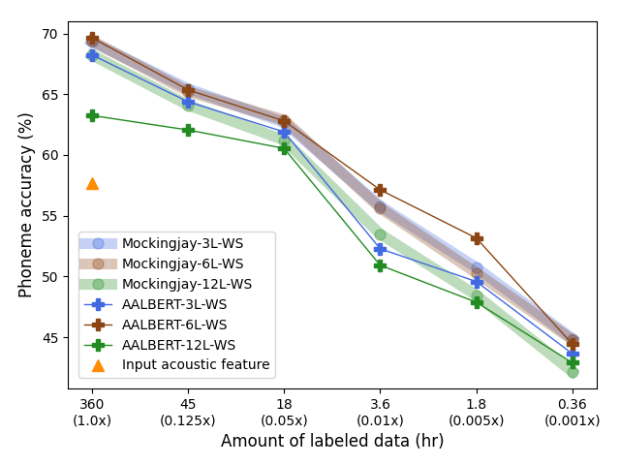
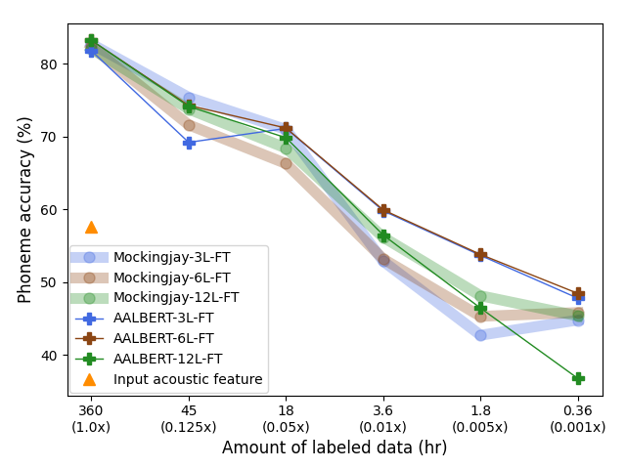
Different Proportion of training data
(Weighted-sum) (Fine-tune)

Slide 15
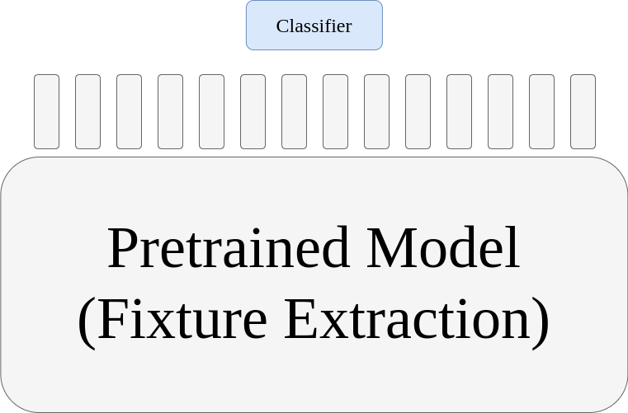
Speaker Identification
Utterance-level
Frame-level
Overall Performance

Slide 16
Utterance-level
Utilizing mean pooling over an utterance to generate utterance-level representation.
Simple linear classifier need to train in the Utterance-level speaker identification

Slide 17
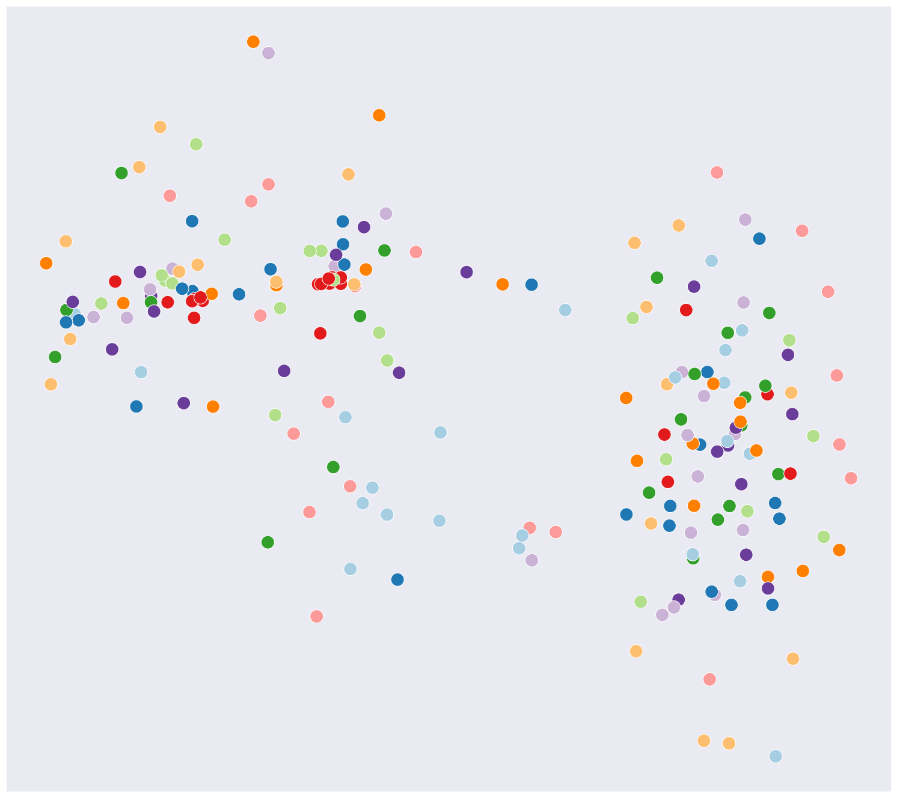
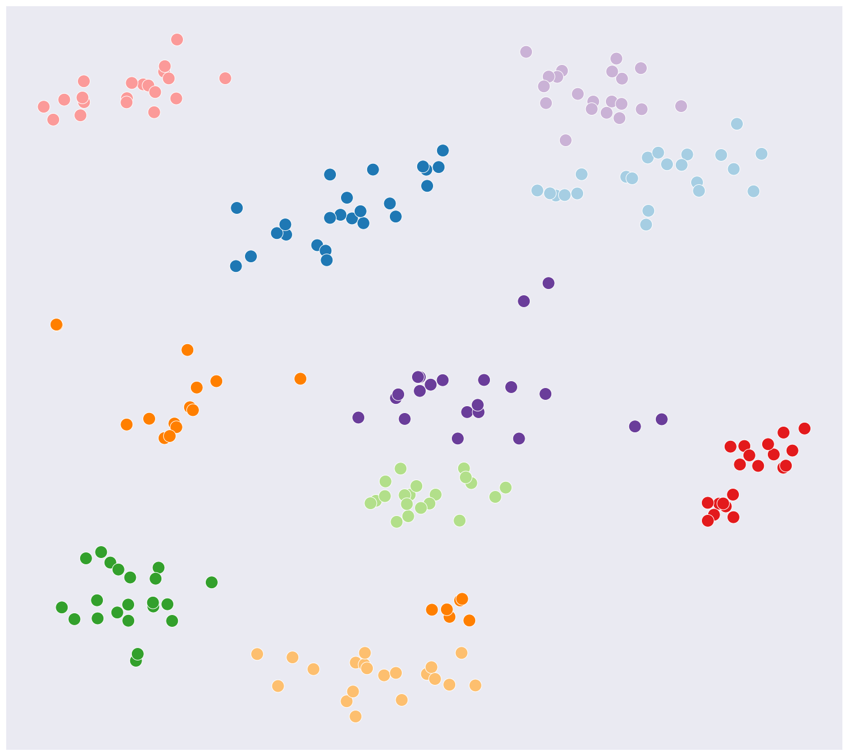
T-sne visualization

Slide 18
Frame-level
Classify Each frame-level representation to corresponding speaker.
Simple linear Classifier need to train in the frame-level speaker identification

Slide 19
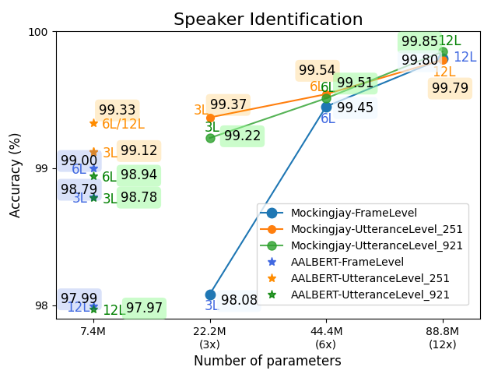
Overall Performance

Slide 20
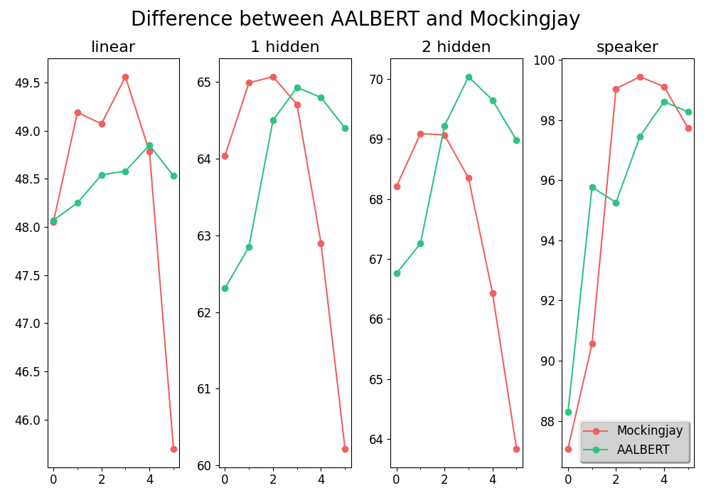
Probing Tasks

